Slide 1
AWS Compute Services
Present by Vishwanath M S
Cloud Architect

Slide 2
Agenda
AWS Networking
EC2-Pricing
Free Services
Your Questions
Computing Services

Slide 3
AWS Networking
VPC → A logically isolated Network section of the AWS cloud, private for every customer.
Subnets →Logical partition of an IP network , an small network segment.
Internet Gateway → Enable access for VPC to the internet.
Route Tables → It determines the routes to reach the outside networks.
Security Groups → It’s a firewall to protect individual EC2 instance.
NACL’s → It’s an firewall applied to the subnets.

Slide 4
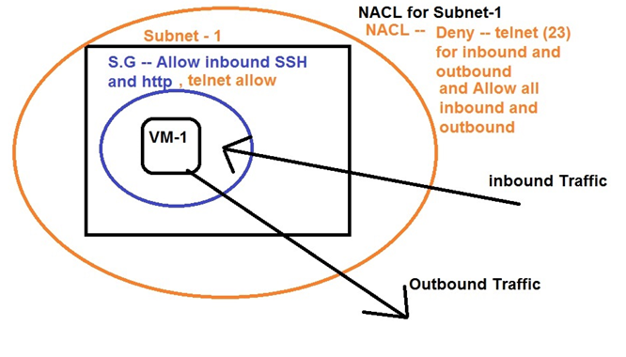
SG’s and NACL’s – AWS Net
Application Layer | Ports – 1- 65536
Transport layer | TCP /UDP
Network Layer | IP Address
Data link Layer | MAC ID

Slide 5

AWS - Networking
Internet
Gateway
VPC-1 → Region – east US
Internet
172.18.0.0/16 – VPC Network -1
Sub1-1
172.18.1.0/24
Sub2-1
172.18.2.0/24
VM-01
LInux
Us-east-1a
Us-east-1b
EAST US
Add routing entry on VPC-1 routing table
0.0.0.0/0 – Internet Gateway
::/0 – Internet Gateway

Slide 6
Computing Services
There are different Computing services that are available in AWS.
But the base of all the compute server is “EC2”.

Slide 7
Computing Services -- Based on EC2
ECS → Elastic Container Service “Docker as a Service” highly scalable, high-performance container orchestration service that support Docker containers, and pay for EC2 used underline.
Fargate → Docker as a service, but we are not bothered about the infrastructure.
EKS → Kubernetes as a Service is an container orchestration engine, with which its easy to deploy, manage and scale containerized applications for large enviroments.

Slide 8
Computing Services -- Based on EC2
Elastic Beanstalk → we could create and orchestrate various AWS services, including EC2, S3, SNS, Cloudwatch, autoscaling and Elastic Load balancers.
AWS Batch → we could plan, schedule and execute the batch computing workloads across the full range of AWS compute services and features like, EC2 and spot instances.

Slide 9
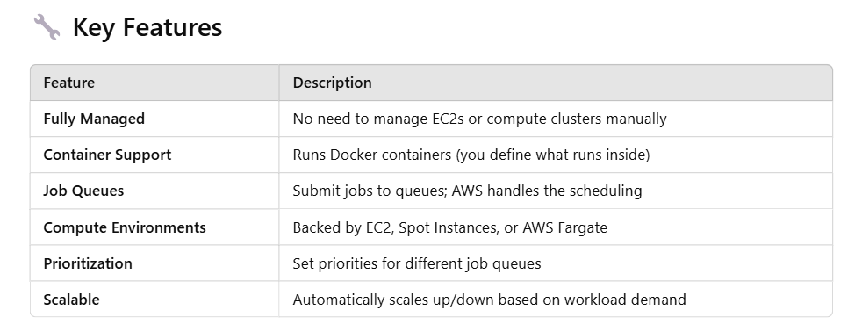
AWS Batch -- continue

Slide 10
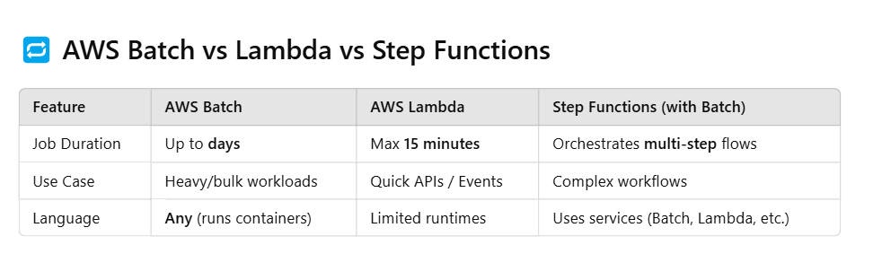
Comparision

Slide 11
EC2 Instance pricing Options
On-Demand Instance:
Pay as you go
Best for immediate demand of EC2 with no pre-defined timelines.

Slide 12
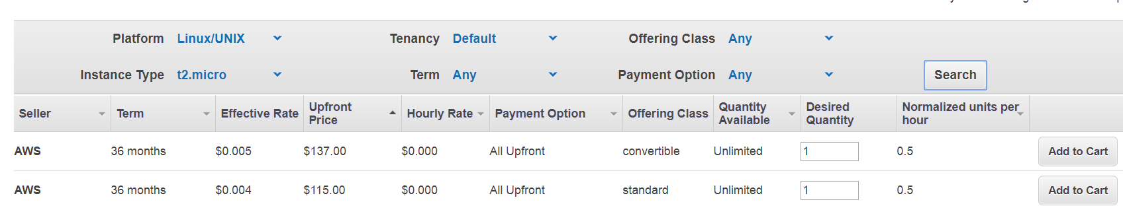
EC2 Instance pricing Options
Reserved Instance:
Customer could opt for 1yr or 3 yrs subscription.
The discount could range from 35% to 65% compared to On-Demand Pricing
Payment terms – ALL UPFRONT, PARTIAL UPFRONT, NO UPFRONT

Slide 13
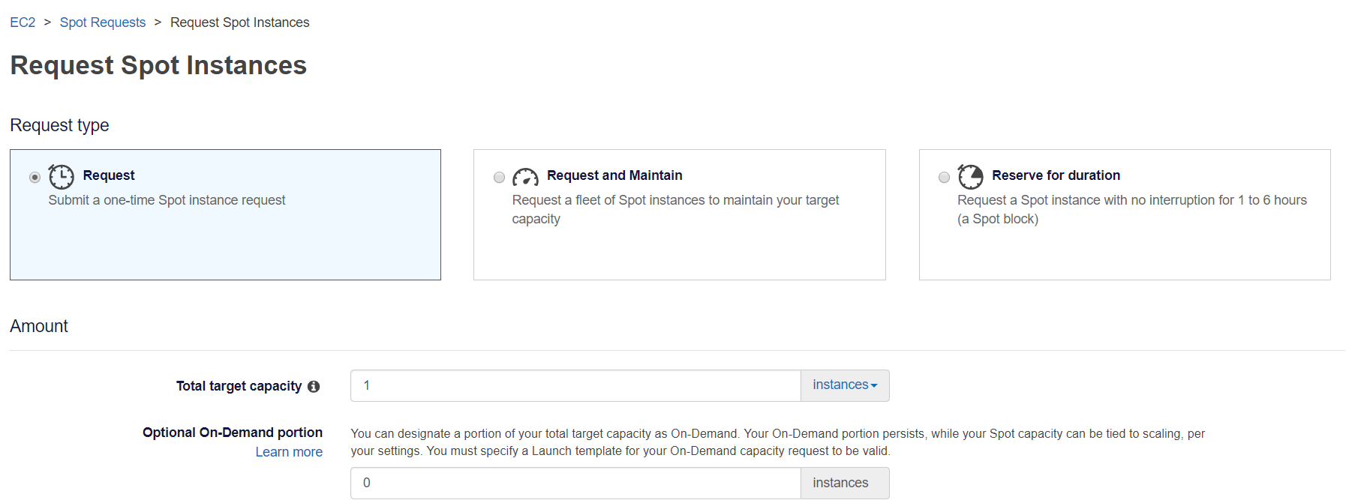
EC2 Instance pricing Options
Spot Instances:
AWS Offers spare compute capacity available for very discounted price compared to On-Demand.
Spot Instances can be interrupted by AWS with two minutes of notification when AWS EC2 needs the capacity back.

Slide 14
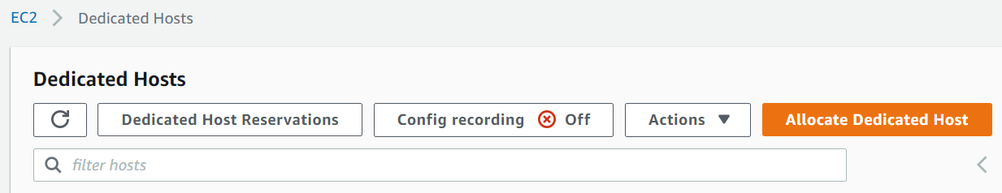
EC2 Instance pricing Options
Dedicated Hosts:
The complete physical server is dedicated to the customer and he pays for the full server.
Customer could create multiple VM’s on this.
Used when the customer needs the same server every time due to the license limitations of the apps.

Slide 15
Free Services
720 hr / Month is free for t2.micro instance type for EC2
30 GB of Amazon Elastic Block Storage
5GB – S3 space is free per month
5GB – Glacier Storage
VPC creation is free
720 hr / Month is free for t2.micro instance type for RDS
1 Million SNS
10 Cloudwatch custom metrics & Alarm
5 GB of AWS EFS
Many More …….

Slide 16
Questions?

Slide 17
Sample Questions
Which of the following Amazon EC2 pricing models allow customers to use existing server-bound software licenses?
A. Spot Instances
B. Reserved Instances
C. Dedicated Hosts
D. On-Demand Instances

